Slide 1


Alabama Chapter-AAP
Practice Management Association
2019 Webinar Series
November 20, 2019 12:15 PM
Tammie Lunceford, CMPE CPC,
Healthcare Consultant
Warren Averett

Slide 2


Webinar Participation
For audio dial:
1 646 558 8656#
then your participant ID
and #
Attendance
Sign your practice name in the Chat Box
Once you have joined by phone or computer’s audio, hit mute to minimize background noise
Notes:
Welcome everyone.
While we are waiting, please go ahead and sign your team into the chat box and list all the individuals from your core team attending this call today.
Please also put your phone on mute by pressing *6
Please also practice pressing *7 to unmute as we will be asking some of you to expand about reminder/recall/ missed opportunity approaches in your practice.

Slide 3
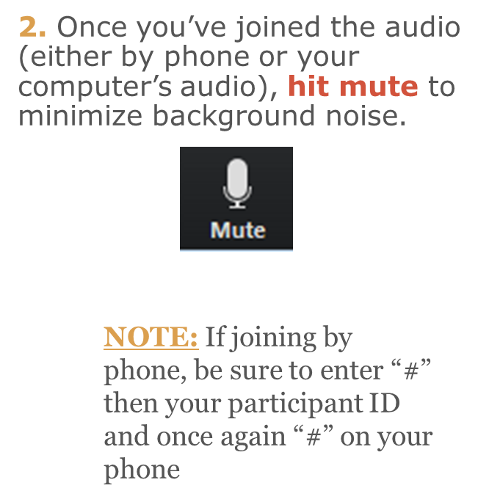
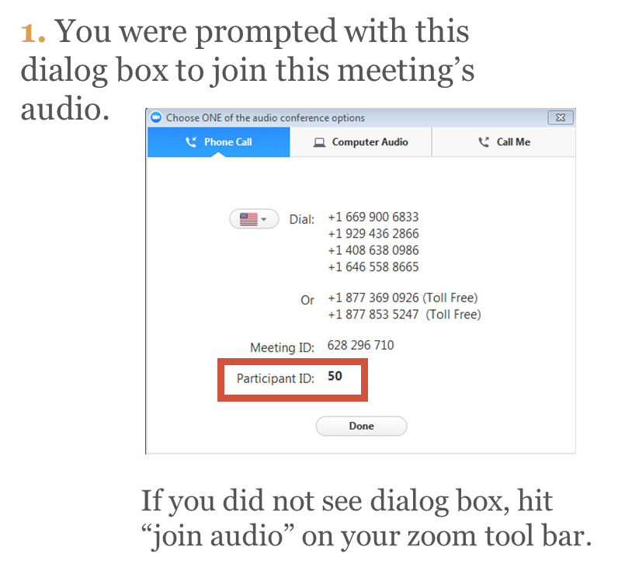

Zoom Reminders & Audio Information

Slide 4

Best Beginnings 2020
January to September
Development
Autism
Social-Emotional
Maternal Depression

Slide 5

Mike Warren Challenge
Children’s of Alabama’s CEO Mike Warren has issued a challenge of the state’s pediatricians for donations for ACHIA, for which he will match additional COA funds up to $10,000. You can make a donation going to this website: https://www.alaap.org/mike-warren-challenge

Slide 6
E & M Coding Changes 2021- How to Prepare
Tammie W. Lunceford CMPE CPC

Slide 7
Overview
E&M Coding Changes 2021
• The E&M Change was finalized as part of the CMS
2020 Physician Fee Schedule but the change is reflected with all payers.
• 1995 and 1997 Documentation guidelines have not
drastically changed in over 30 years.
• Physician and other billable providers are not trained on coding, billing and documentation principles in
their medical training.

Slide 8
Why change?
E&M Coding Change 2021
Outdated
Guidelines
Simplification
Teachable
Focus on Patient
MDM or Time
Meaningful Documentation
Value

Slide 9
Why change? Other reasons
E&M Coding Change 2021
EHR’s have changed the way physician’s document.
• We went from poor handwriting to not being able
to understand multiple pages of documentation.
• Patient behaviors have changed! They do not
visit the physician regularly. Some visits are more
detailed than others.

Slide 10
Who is making changes?
E & M Coding Change 2021
CMS and AMA shared goal for reduction of burden, AMA controls CPT Panel
The CPT Editorial Panel had four objectives:
Decrease Documentation Burdens
Decrease Audits Expand Key Definitions
Decrease Unnecessary Documentation
Ensure E/M Payment is Resource Based

Slide 11
What codes are changing?
E&M Coding Changes 2021
• New Patient Visits -99202- 99205, 99201 is deleted
Established Patient Visits- 99211-99215
• Comprise 20% of all Medicare allowed charges
• Primarily furnished in outpatient settings and physician offices.
• 2020 CPT books will not reveal any changes to E/M

Slide 12
New or established?
E&M Coding Changes 2021
Determination of Patient Status is Unchanged
New Patient- a patient who has not received professional services from a physician in the same
specialty, in the same practice for three years.
When the NP or PA is working with a physician they are considered as working in the exact same specialty and the exact same sub-specialties as the physician.

Slide 13
Code Descriptions
E&M Coding Changes 2021
2021Code descriptions for CPT 99202-99205 and 99211-99215 no longer include the elements of history and physical exam to determine the level of the visit.
If it is medically necessary to perform any extent of history or physical exam to treat the patient, it should be performed and documented.

Slide 14
Code Description example
E&M Coding Changes 2021
99203 Office or other outpatient visit for the
evaluation and management of a new patient,
which requires a medically appropriate history
or examination and low level of medical
decision-making.
When using time for code selection, 15-29 minutes of total time is spent on the date of the encounter.

Slide 15
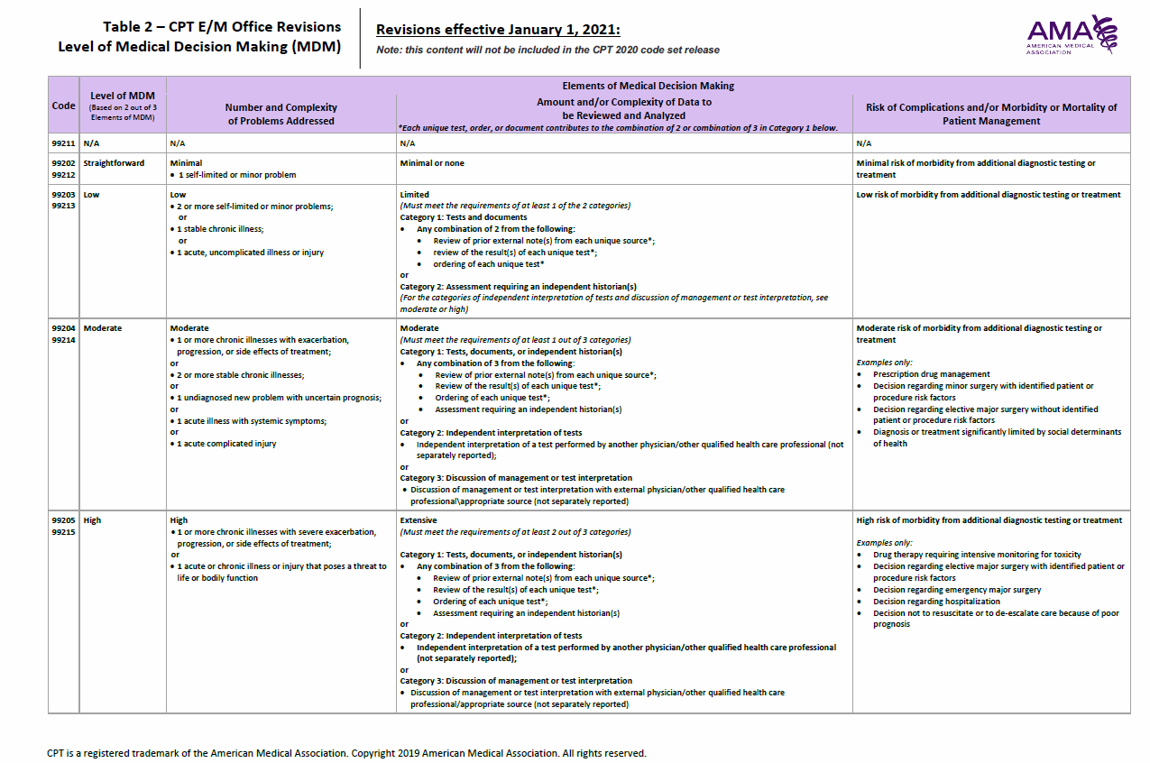
Medical Decision-making
E&M Coding Changes 2021

Slide 16
Medical Decision-making
E&M Coding Changes 2021
Currently, a provider can code a 99214 solely based on the level of history and exam without changing treatment or addressing the MDM.
In 2021, if a provider chooses to bill using MDM, the code will be chosen based on the medically necessary history and exam and the actions taken to treat, manage or improve the patient’s health.

Slide 17
Coding time
E&M Coding Changes 2021
Total Time on the Date of the Encounter includes face-to-face and non-face-to-face time personally spent by the physician or other qualified health care professional.
Does not include: time normally spent by clinical staff or preparation prior to the date of the encounter. The guideline no longer specifies “more than 50% must be counseling”.

Slide 18
Documentation elements-time
E&M Coding Changes 2021
• Total time must be stated in the documentation
• Preparing to see the patient- review of tests
• Obtaining or reviewing medically appropriate history
• Performing medically appropriate physical exam
• Counseling and educating the patient or caregiver
• Ordering medications, tests or procedures
• Referring and communicating with other health professionals
• Documentation in EHR
• Interpreting and communicating test results
• Care coordination

Slide 19
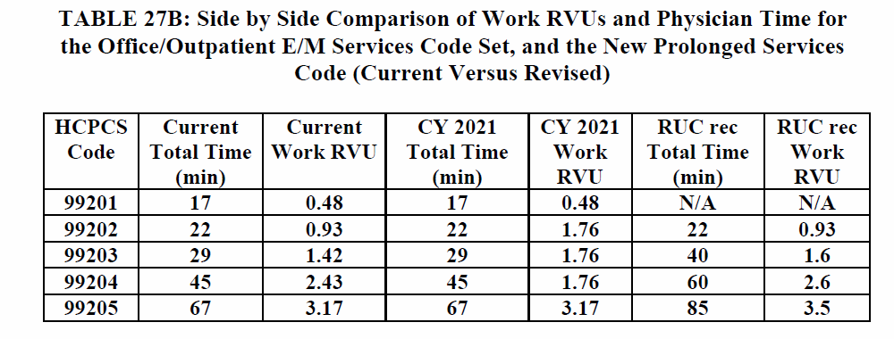
New Time per CPT code-new Pt
E&M Coding Changes 2021

Slide 20
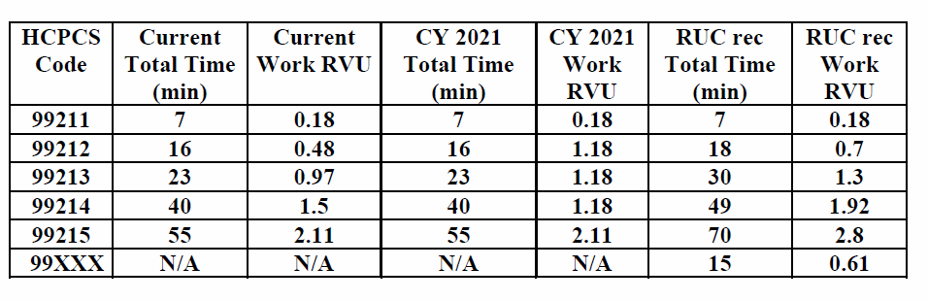
New Time per CPT- Established
E&M Coding Changes 2021

Slide 21
Preparing physicians and staff
E&M Coding Changes 2021
Update EHR
Review Workflow
Business & Clinical
Train Physicians/Providers on Documentation Requirements
Train Managers, Staff, Billers on New Guidelines
Update Internal Policies

Slide 22
What’s the big deal?
E&M Coding Change 2021
Accurate Patient Record
Physician
Thought Process
Structure
NP, PA, Scribe
Effective
EHR
Manage, Evaluate, Treat, Assess
Document must “Stand Alone”
ICD Specificity

Slide 23
Reimbursement
E&M Coding Changes 2021
Levels 2-5 established office visit codes average increase is more than 29%.
Decision Health projects more than 2 million in additional payments for codes 99203-99204 based on announced rates.
Each office visit CPT code will have a separate reimbursement rate opposed to previous announcements

Slide 24
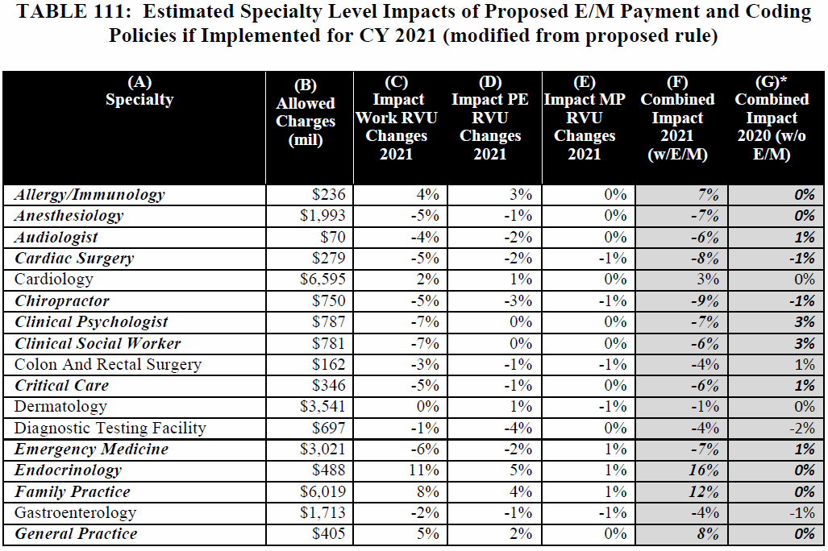
Financial impact
E&M Coding Changes 2021

Slide 25
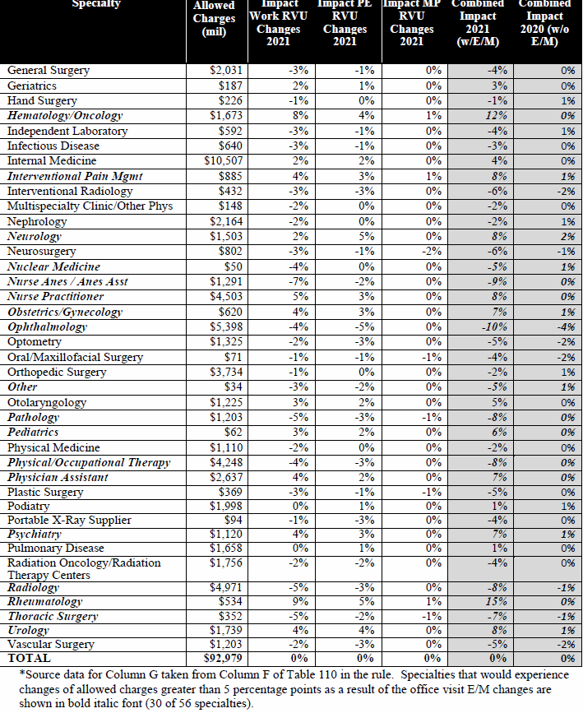

Slide 26
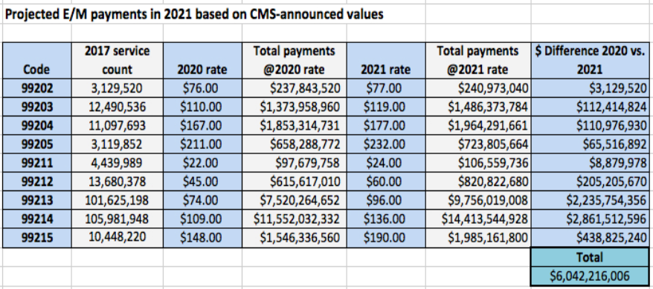
Big Bucks
E&M Coding Changes 2021
Per CMS Learning Session on August 12, 2019

Slide 27
conclusion
E&M Coding Changes 2021
"It is not the strongest or the most intelligent who will survive but those who can best manage change." - ...
Charles Darwin

Slide 28
Resources
E&M Coding Changes 2021
Summary: 2020 Medicare Physician Fee Schedule and Quality ...
www.ama-assn.org/system/files/2019-08/2020-pfs-qpp-final-rule.pdf
https://www.hfma.org/.../fs-cy2020-physician-fee-schedule-proposed-rule2-081519.pdf
www.MGMA.com
https://pbn.decisionhealth.com

Slide 29
TAMMIE W. LUNCEFORD, CMPE, CPC
Consultant
2500 Acton Road | Birmingham, AL 35243
D 205.769.3262 | F 205.979.6313
Tammie.Lunceford@warrenaverett.com
Profile
Tammie Lunceford serves Warren Averett as a dental and healthcare consultant. She obtained her Bachelor of Science in Health Administration from UAB in 1995. Tammie is a Certified Medical Practice Executive, CMPE, Certified Professional Coder, CPC and registered with the American Society of Pathology as a medical laboratory technician, collectively bringing her clinical and administrative experience to more than 25 years. Tammie was formerly the Director of Primary Care University of Alabama Health Services Foundation and Director of Business Operations Urology Centers of Alabama. She has served in an Administrator or Director role in multiple specialties, with health systems, private practice, and medical management organizations. Tammie serves medical and dental practices by evaluating scheduling, patient flow, operational efficiencies, revenue cycle management, and EMR selection process and planning. In addition, she has experience with the Merit Based Incentive Program. Throughout this past year held workshops for Alabama MGMA State Conferences and regional workshops across Florida and Alabama, including the Medical Association for the State of Alabama.
Professional affiliations:
• State and Local Medical Group Management Association
• American Association of Professional Coders
• American Society of Clinical Pathology

