Slide 1
COVID-19 Vaccine
Katrina Skinner, MD

Slide 2
What Is Science?
A branch of knowledge or study dealing with a body of facts or truths systematically arranged and showing the operation of general laws.

Slide 3
To Think On
2 Timothy 1:7
For God has not given us a spirit of fear, but of power and of love and of a sound mind.
Proverbs 14:15
The simple believes everything, but the prudent gives thought to his steps.
Matthew 7:15
Beware of false prophets, who come to you in sheep’s clothing, but inwardly they are ravenous wolves.

Slide 4
Social Media’s Influence
“Attention grabbing headlines with sensationalist content can attract even the savviest internet users and studies have shown they tend to generate more user engagement. As a result, content personalisation algorithms can repeatedly expose people to the same or similar content and ads even on the basis of disinformation.”
Organisation for Economic Cooperation and Development, in July, 2020

Slide 5
Why Does the Anti-Vax Movement “Move” Us?
Because they play on our emotions, not our rational mind.

Slide 6
How Do We Make a Difference?
Educate ourselves.
Lead by example.
Give a strong, personalized message.

Slide 7
Important Terms
Active Immunity Passive Immunity
Vaccination and Illness - Outside source, antibodies
Long-lasting - Shorter protection
Can take days to weeks for effects - Immediate effects

Slide 8
History of Vaccines
Evidence exists that the Chinese employed smallpox inoculation as early as 1000 CE.
Edward Jenner’s innovations, begun with his successful 1796 use of cowpox material to create immunity to smallpox, quickly made the practice widespread.
Louis Pasteur’s 1885 rabies vaccine was the next to make an impact on human disease.
Notes:
Innovative techniques now drive vaccine research, with recombinant DNA technology and new delivery techniques leading scientists in new directions. Disease targets have expanded, and some vaccine research is beginning to focus on non-infectious conditions such as addiction and allergies.

Slide 9
mRNA Vaccines
The use of RNA vaccines goes back to the early 1990s
mRNA vaccines have been studied before for flu, Zika, rabies, and cytomegalovirus (CMV).
mRNA vaccines go through rigorous studies just as all other types of vaccines in the United States.
Only COVID 19 vaccines that meet these standards will be approved.
Notes:
The use of RNA vaccines goes back to the early 1990s
mRNA vaccines have been studied before for flu, Zika, rabies, and cytomegalovirus (CMV).
mRNA vaccines go through rigorous studies just as all other types of vaccines in the United States.
Only COVID 19 vaccines that meet these standards will be approved.
mRNA vaccines are safe for use in pregnancy and lactating women.
RNA vaccines are faster and cheaper to produce than traditional vaccines, and a RNA based vaccine is also safer for the patient, as they are not produced using infectious elements
Production of RNA vaccines is laboratory based, and the process could be standardised and scaled, allowing quick responses to large outbreaks and epidemics
Most current research is into RNA vaccines for infectious diseases and cancer, for which there are several early-stage clinical trials, there is also some early research into the potential of RNA vaccines for allergies
There is still a lot of work to be done before mRNA vaccines can become standard treatments, in the meantime, we need a better understanding of their potential side effects, and more evidence of their long term efficacy

Slide 10
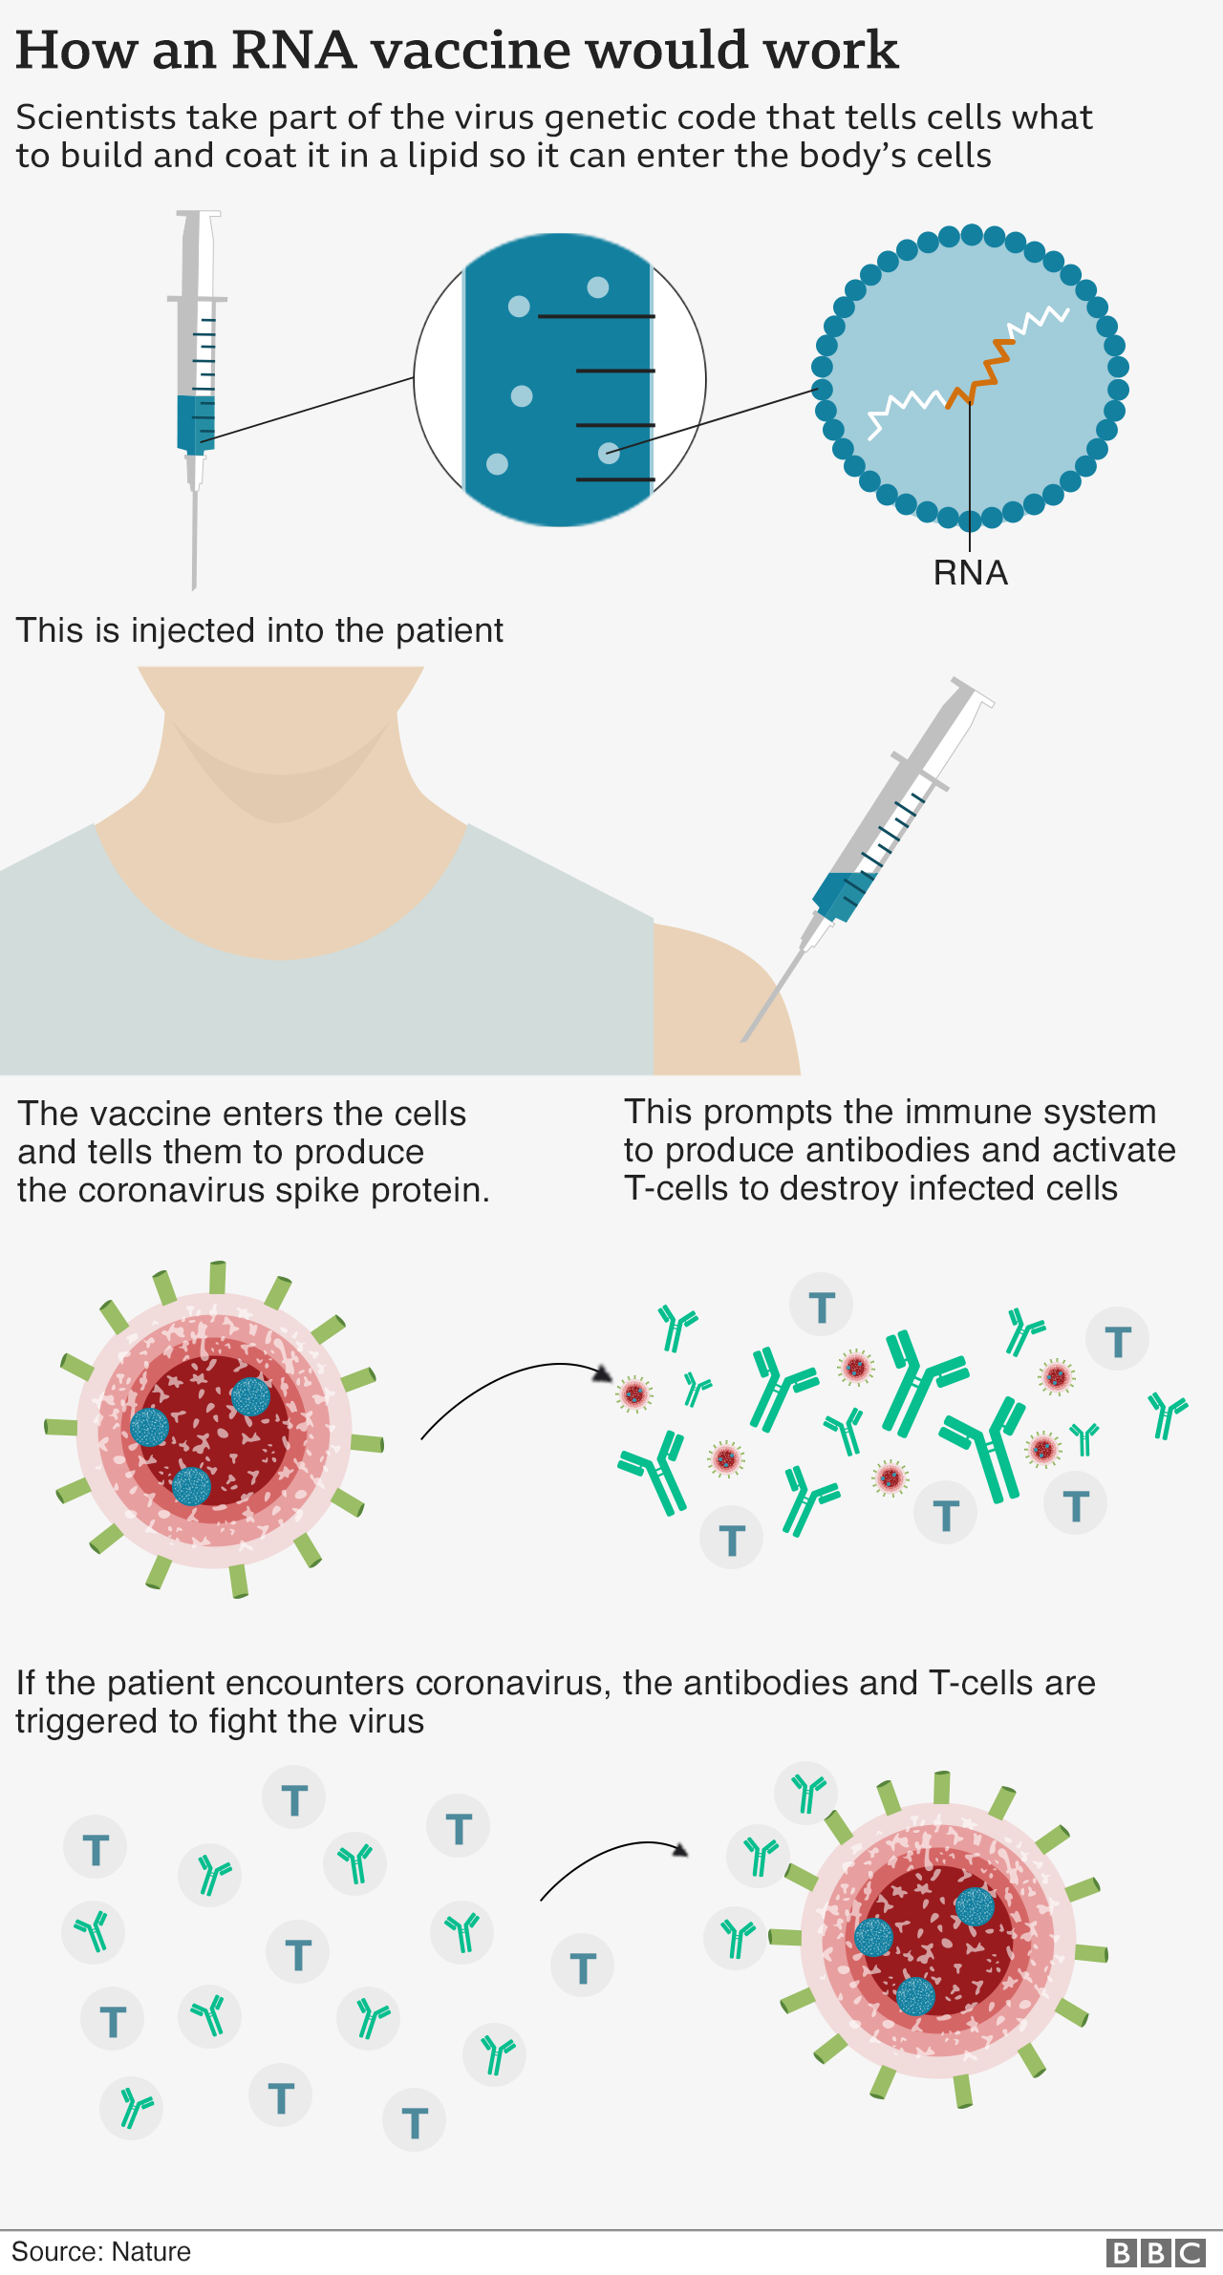
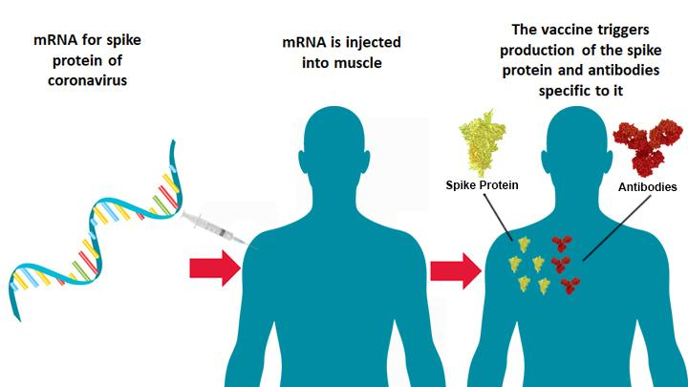
Understanding mRNA Vaccine
Notes:
mRNA vaccines teach our cells how to make a protein—or even just a piece of a protein—that triggers an immune response inside our bodies. That immune response, which produces antibodies, is what protects us from getting infected if the real virus enters our bodies.
COVID-19 mRNA vaccines give instructions for our cells to make a harmless piece of what is called the “spike protein.” The spike protein is found on the surface of the virus that causes COVID-19.
Once the instructions (mRNA) are inside the immune cells, the cells use them to make the protein piece. After the protein piece is made, the cell breaks down the instructions and gets rid of them.
Next, the cell displays the protein piece on its surface. Our immune systems recognize that the protein doesn’t belong there and begin building an immune response and making antibodies, like what happens in natural infection against COVID-19.
mRNA does not linger in our cells for long. Once it has passed its instructions to the protein-making machinery in our cells, enzymes called ribonucleases (RNases) degrade the mRNA.
It is not possible for mRNA to move into the nucleus of a cell as it lacks the signals that would allow it to enter this compartment. This means that RNA cannot integrate into the DNA of the vaccinated cell.
There is no risk of long-term genetic changes with mRNA vaccines.
At the end of the process, our bodies have learned how to protect against future infection. The benefit of mRNA vaccines, like all vaccines, is those vaccinated gain this protection without ever having to risk the serious consequences of getting sick with COVID-19.
How does mRNA work in my body?
How long do I have immunity?
How will I feel after the vaccine?
Why do I have to get 2 doses?
I have underlying health conditions, is the vaccine safe for me?

Slide 11
Breastfeeding and Pregnancy with the vaccine
Breastfeeding
Vaccine is unlikely to enter blood stream
Protect mommy...protect baby
ACOG and The Academy of Breastfeeding Medicine recommends
Pregnancy
Risk vs. Benefit
ACOG recommends pregnant healthcare professionals to get vaccinated
COVID positive pregnant women are 5 times more likely to end up in ICU
Notes:
During lactation, it is unlikely that the vaccine lipid would enter the blood stream and reach breast tissue. If it does, it is even less likely that either the intact nanoparticle or mRNA transfer into milk. In the unlikely event that mRNA is present in milk, it would be expected to be digested by the child and would be unlikely to have any biological effects.”

Slide 12
mRNA Covid Vaccine Myths
We cannot trust the vaccine because it was rushed
The vaccine will give me COVID 19
We do not know what’s in these vaccines
These vaccines will alter my DNA
The vaccine contains a microchip
The vaccine contains aborted fetal cells
Notes:
mRNA does not linger in our cells for long. Once it has passed its instructions to the protein-making machinery in our cells, enzymes called ribonucleases (RNases) degrade the mRNA.
It is not possible for mRNA to move into the nucleus of a cell as it lacks the signals that would allow it to enter this compartment. This means that RNA cannot integrate into the DNA of the vaccinated cell.
There is no risk of long-term genetic changes with mRNA vaccines.

Slide 13
Post Vaccine Questions
Do I still wear a mask and social distance after the vaccine?
If the majority of the world is vaccinated, when will life get back to normal?
Will I have to get another round of vaccines every year?
Does the vaccine cover the new strain of COVID-19?

Slide 14
Wrap It All Up
Questions???

